Slide 1
Adjoint-Based Sensitivity Analysis for Computational Fluid Dynamics
Dimitri J. Mavriplis
Max Castagne Professor
Department of Mechanical Engineering
University of Wyoming
Laramie, WY USA

Slide 2
Motivation
Computational fluid dynamics analysis capabilities commonplace today
In addition to analysis capability, sensitivity capability is highly desirable
Design optimization
Error estimation
Parameter sensitivity
Sensitivities may be obtained by:
Perturb input, rerun analysis code (Finite difference)
Linearizing analysis code (tangent method)
Good for 1 input, many outputs
Adjoint method (Pironneau, Jameson, many others…)
Good for many inputs, one output

Slide 3
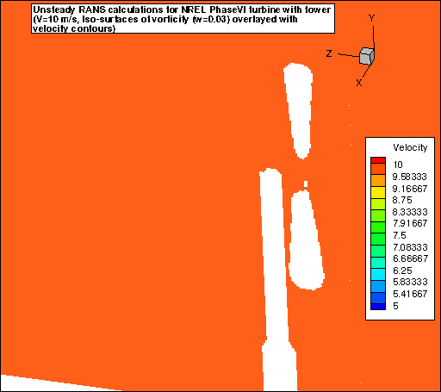
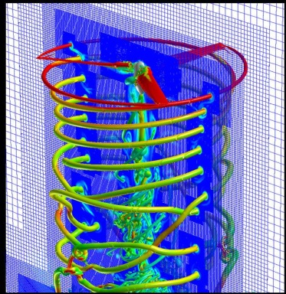
Objective
Demonstrate methodical approach for formulating and implementing discrete adjoint to increasingly complex problems
Progressively more complex simulation sensitivity formulations
Steady-state aerodynamics (3D)
Time-dependent aerodynamics (2D)
Time-dependent coupled aero-elastic (3D)
Focus
Adjoint formulation
Hand coded (occasional use of AD)
Same data structures/solution techniques as analysis
Verification
Exact full sensitivities in all cases
Optimization examples are simply illustrative
Time-dependent
Aeroelastic
Overset meshes
Adaptive meshes

Slide 4
Adjoint Sensitivity Formulation
Continuous vs. Discrete Adjoint Approaches
Continuous: Linearize then discretize
Discrete: Discretize then Linearize
Continuous Approach:
More flexible adjoint discretizations
Framework for non-differentiable tasks (limiters)
Often invoked using flow solution as constraint using Lagrange multipliers
Discrete Approach:
Reproduces exact sensitivities of code
Verifiable through finite differences
Relatively simple implementation (but tedious)
Chain rule differentiation of analysis code
Transpose these derivatives
(transpose and reverse order)
Includes boundary conditions
Automation possible (but use judiciously for efficiency reasons)

Slide 5
Adjoint Sensitivity Formulation
Continuous vs. Discrete Adjoint Approaches
Continuous: Linearize then discretize
Discrete: Discretize then Linearize
Continuous Approach:
More flexible adjoint discretizations
Framework for non-differentiable tasks (limiters)
Often invoked using flow solution as constraint using Lagrange multipliers
Discrete Approach:
Reproduces exact sensitivities of code
Verifiable through finite differences
Relatively simple implementation (but tedious)
Chain rule differentiation of analysis code
Transpose these derivatives
(transpose and reverse order)
Includes boundary conditions
Automation possible (but use judiciously for efficiency reasons)

Slide 6
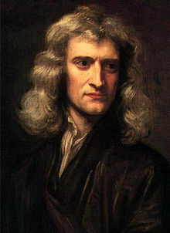
Adjoint Sensitivity Formulation
Continuous vs. Discrete Adjoint Approaches
Continuous: Linearize then discretize
Discrete: Discretize then Linearize
Continuous Approach:
More flexible adjoint discretizations
Framework for non-differentiable tasks (limiters)
Often invoked using flow solution as constraint using Lagrange multipliers
Discrete Approach:
Reproduces exact sensitivities of code
Verifiable through finite differences
Relatively simple implementation (but tedious)
Chain rule differentiation of analysis code
Transpose these derivatives
(transpose and reverse order)
Includes boundary conditions
Automation possible (but use judiciously for efficiency reasons)

Slide 7
Discrete Adjoint Formulation (a simplified view)
Objective:
Subject to:
R = 0 : flow solution converged
u : flow variables (solution)
D: design parameters (shape parameters)
Sensitivities:
Constraint sensitivity eqn:
Final form:
hard
easy

Slide 8
Discrete Adjoint Formulation
Sensitivity equation:
Adjoint equation:
No dependence on D
Dependence on L
Final form:
Cost is independent of number of D’s
dL/dD are then used by a gradient based optimizer to find next best shape
Evaluate first, define as Λ^{T}

Slide 9
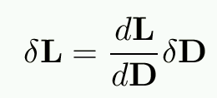
Generalized Discrete Sensitivities
Consider a multi-phase analysis code:
L = Objective(s)
D = Design variable(s)
Sensitivity Analysis
Using chain rule:

Slide 10
Tangent Model
Special Case:
1 Design variable D, many objectives L
Precompute all stuff depending on single D
Construct dL/dD elements as:

Slide 11
Adjoint Model
Special Case:
1 Objective L, Many Design Variables D
Would like to precompute all left terms
Transpose entire equation:

Slide 12
Adjoint Model
Special Case:
1 Objective L, Many Design Variables D
Would like to precompute all left terms
Transpose entire equation: precompute as:

Slide 13
Shape Optimization Problem
Multi-phase process:

Slide 14
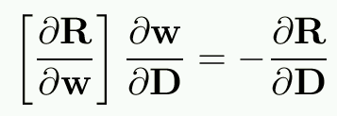
Tangent Problem
1: Surface mesh sensitivity:
2: Interior mesh sensitivity:
3: Residual sensitivity:
4: Flow variable sensitivity:
5: Final sensitivity

Slide 15
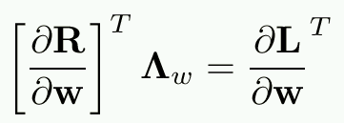
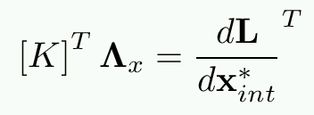
Adjoint Problem
1: Objective flow sensitivity:
2: Flow adjoint:
3:Objective sens. wrt mesh:
4: Mesh adjoint:
5: Final sensitivity:

Slide 16
General Approach
Linearize each subroutine/process individually in analysis code (tangent or forward model)
Check linearization by finite difference/complex variables
Transpose to get adjoint, and check duality relation
Should reproduce same sensitivities to machine precision
Build up larger components
Check linearization, duality relation
Check entire process for FD/Complex and duality
Use single modular AMG solver for all phases
Maintaining forward linearization has advantages
Cases with few design variables, many objectives
Debugging adjoint code
Enables exact Jacobian/vector products for Krylov solve
More later…

Slide 17
Verification: Complex Step
Finite difference approach is plagued by round-off error (small ε) versus non-linear error (large ε)
Must find range of ε that gives accurate sensitivities
Sometimes no such range exists
Complex variable approach:
Replace f(x) with complex function f(x+iε)
Then df/dx = Im(f(x+iε))/ε
Can take ε=1.e-100 (no roundoff error)
Very accurate gradients (machine precision)

Slide 18
General Duality Relation
Analysis Routine:
Tangent Model:
Adjoint Model:
Duality Relation:
Necessary but not sufficient test
Check using series of arbitrary input vectors

Slide 19
General Duality Relation
Analysis Routine:
Tangent Model:
Adjoint Model:
Duality Relation:
Necessary but not sufficient test
Check using series of arbitrary input vectors

Slide 20
Optimization Procedure
Deform airfoil surface as a function of D
Run flow solver to obtain steady solution
Compute objective function L^{g}
Perturb D by δD
Set δD = 0
Check L^{g}
start
stop
Compute design variable perturbation as:
Run adjoint solver to compute sensitivities
(or provide gradient to optimizer)

Slide 21
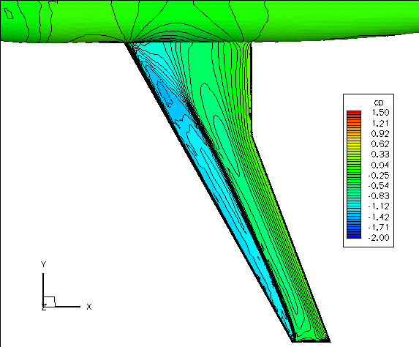
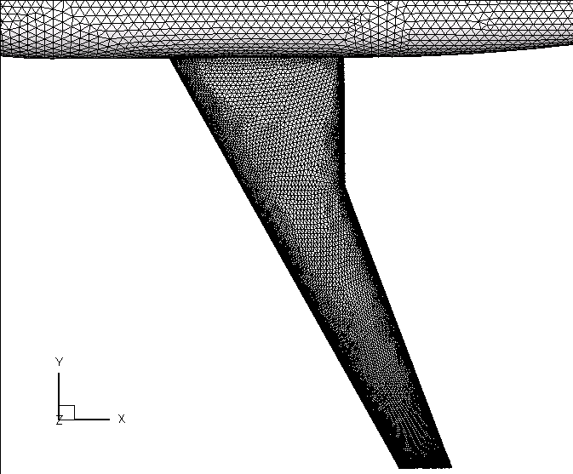
Drag Minimization Problem
DLR-F6 Wing body configuration (1.2M points)
Mach=0.75, Incidence=1º , Re=3M

Slide 22
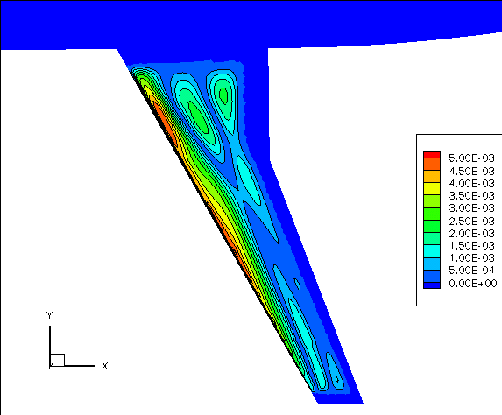
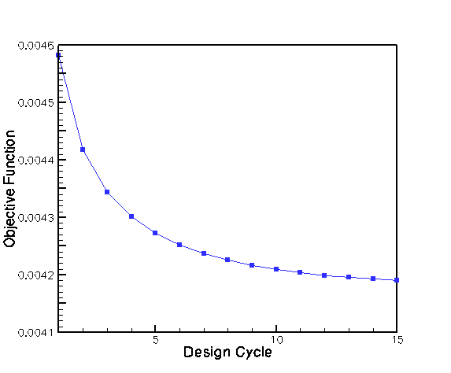
Drag Minimization Problem
Total Optimization Time for 15 Design Cycles:
6 hours on 16 cpus of PC cluster
Flow Solver: 150 MG cycles
Flow Adjoint: 50 Defect-Correction cycles
Mesh Adjoint: 25 MG cycles
Mesh Motion: 25 MG cycles

Slide 23
Optimization for Time Dependent Problems
Using chain rule linearization
New time-step values depend on previous time step values
Integrate linearized equation in time (tangent problem)
Transpose all to get adjoint (and reverse order of matrix multiplication)
Integrate backwards in time
Requires storing entire time history (to disk)
10 8-Byte variables per grid point per time step
Advantage of using large time steps with good implicit solver
Use local node disks on parallel computer (>1TB each node)
Similar to data-assimilation problem (4DVAR)

Slide 24
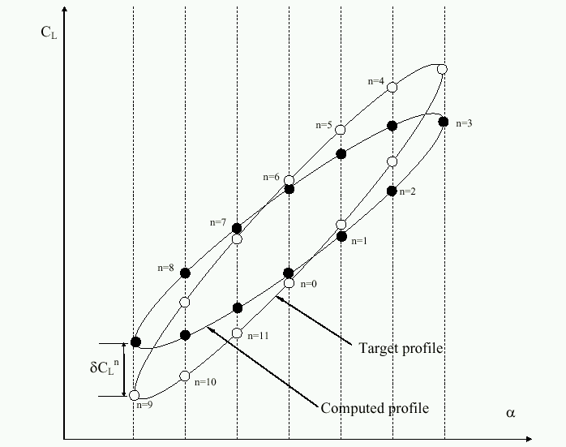
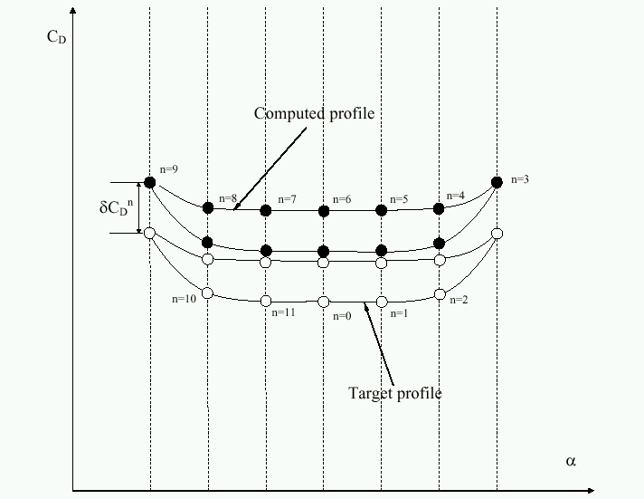
Time-Integrated Objective Formulation
Pitching airfoil time histories of CL and CD

Slide 25
Unsteady Flow Solution Mani and Mavriplis AIAA 2007-0060
Pressure Contours for Pitching Airfoils
M_{inf} = 0.755, α₀ = 0.016º, α_{max} = 2.51º, ω = 0.1628, t=0 to 54
27 time-steps with dt=2.0
NACA0012 Baseline Airfoil
Optimized Airfoil

Slide 26
Time-Dependent Load Convergence Mani and Mavriplis AIAA 2007-0060

Slide 27
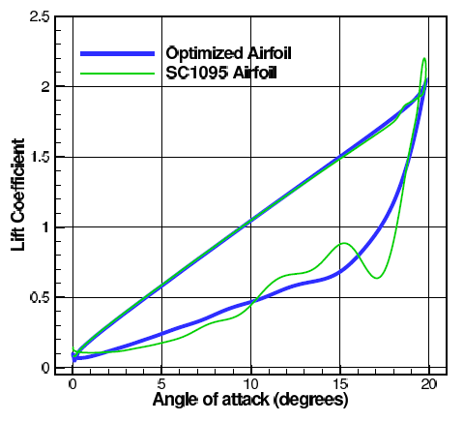
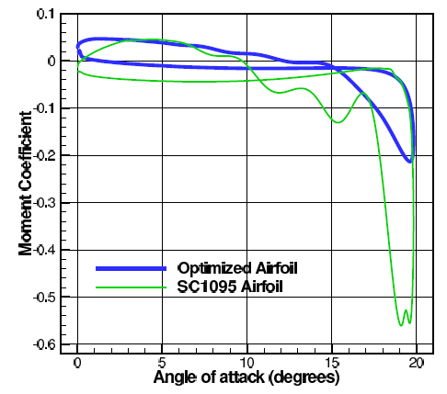
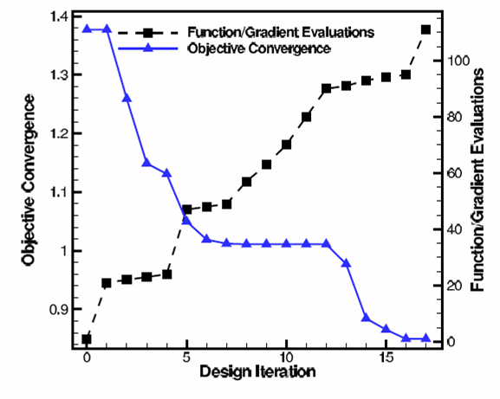
Dynamic Stall Optimization
Optimized airfoil performance: Objective=Minimize moment excursions at constant lift

Slide 28
Extension to Multidisciplinary Problems: Time-Dependent Aeroelasticity
Fully coupled problem involves 4 modules:
Flow solver
Structural Solver
Mesh deformation
Fluid-structure interface (FSI)
Adjoint formulation leads to :
Disciplinary adjoints: Fluids, Structures, Mesh, FSI
Disciplinary adjoints are coupled at each time step
Coupled adjoint solver analogous (transpose) of coupled aeroelastic analysis solver
Demonstrated flutter suppression through shape optimization in 2D
Mani and Mavriplis AIAA 2008-6242

Slide 29
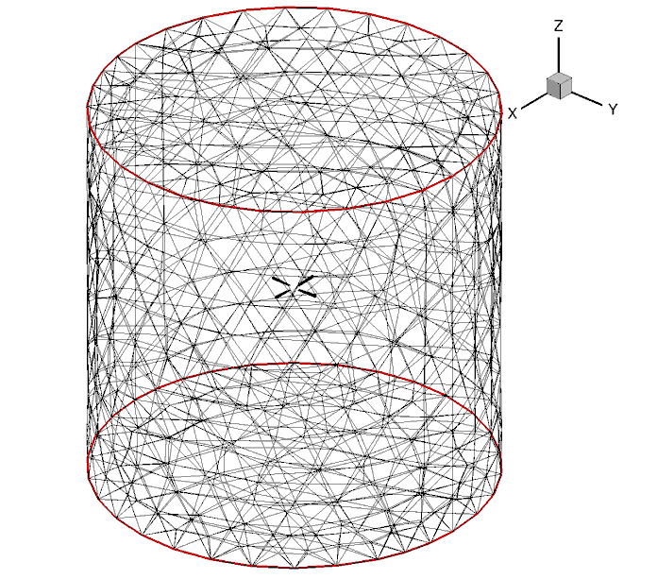
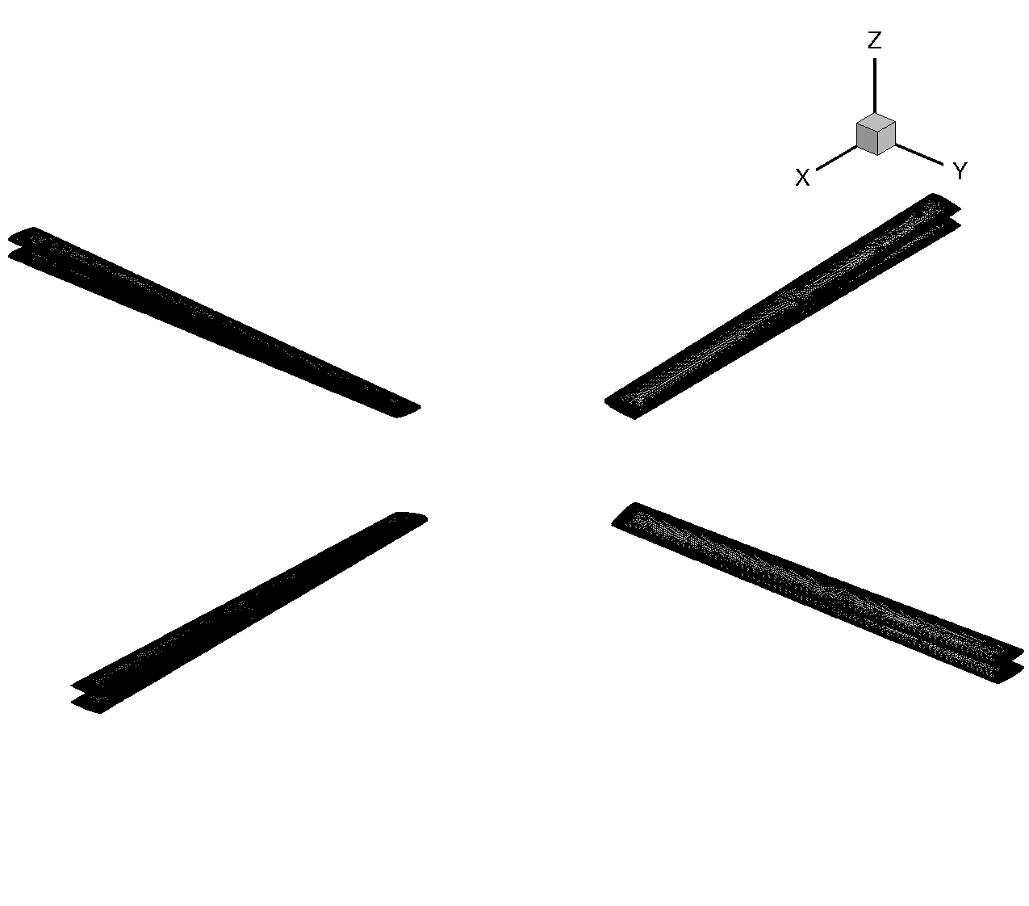
3D Test Problem
4 bladed Hart-II rotor in hover:
Rigid blade
Flexible blade
CFD/CSD specifications:
2.32 million grid nodes (prisms, pyramids, tets)
20 beam elements
Tight CFD/CSD coupling
3 rotor revs (dt=2^{O})
6 coupling per time step, 10 CFD and 5 CSD non-linear iterations per coupling
~1 hr/rev with 512 cores
CFD flow domain
Rigid and Flexible blades

Slide 30
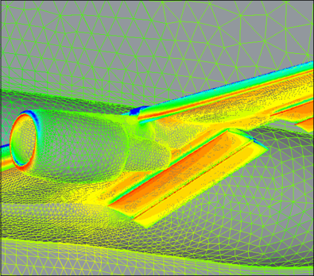
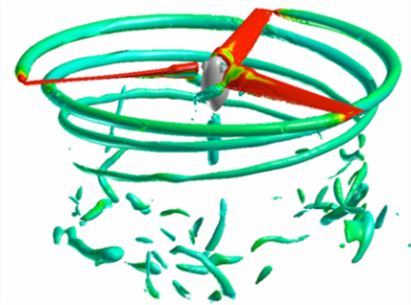
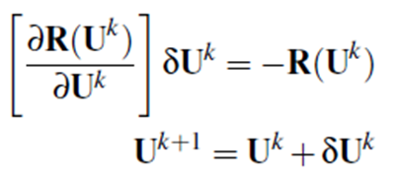
Aerodynamic Solver: NSU3D
3D unstructured mesh finite-volume RANS solver
2nd –order accurate in space and time.
One equation Spalart-Allmaras turbulence model.
Deforming mesh capability with GCL compliance
Fully implicit discretization solved using Newton’s method at each time-step as:
Preconditioned GMRES used for linear system
Forward linearization used for exact Jacobian-vector products
Linear agglomeration multigrid for preconditioner
Line implicit solver as smoother for linear multigrid

Slide 31
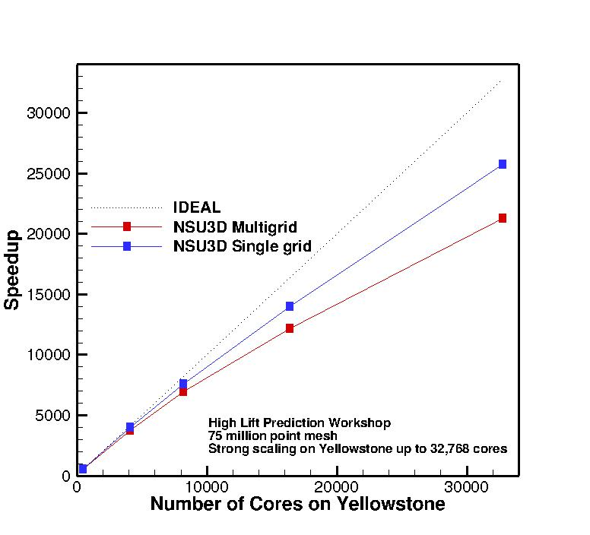
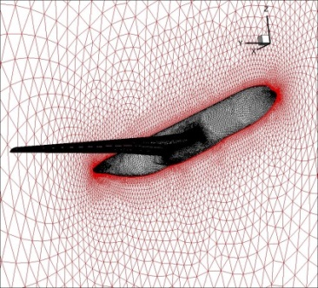
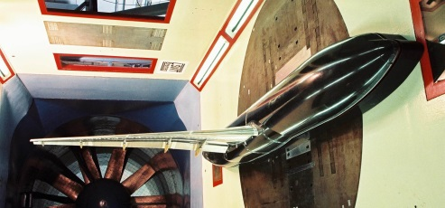
Strong scaling of AMG solver up to 32K cores

Slide 32
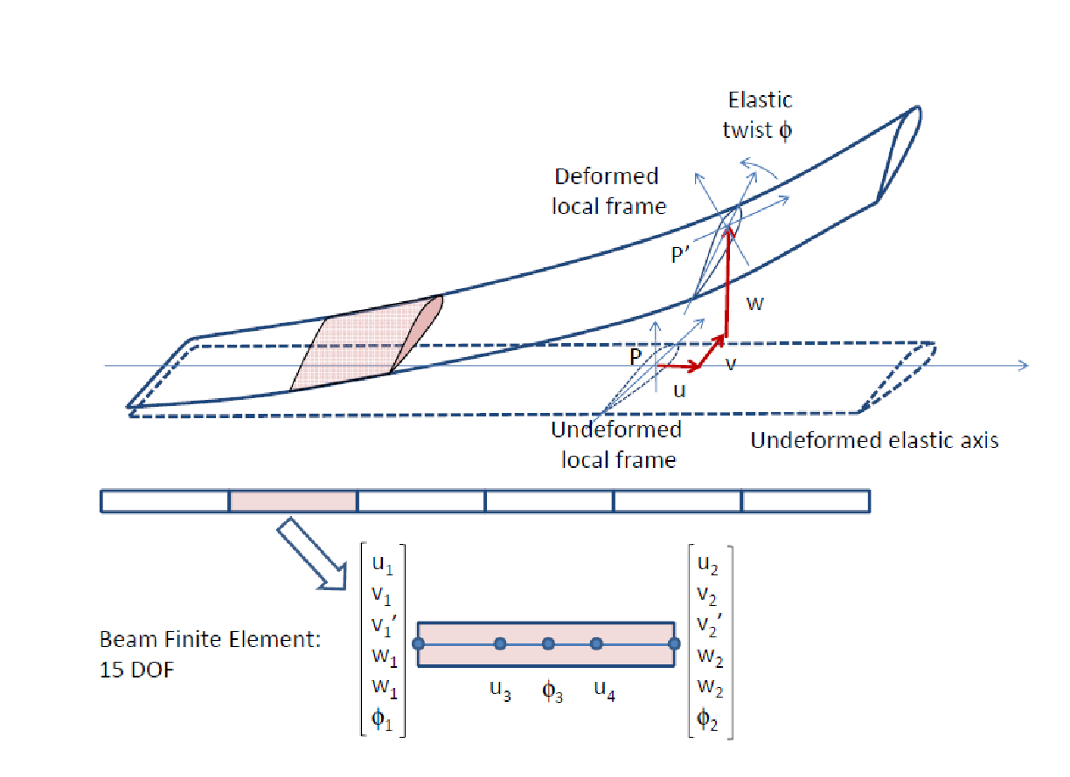
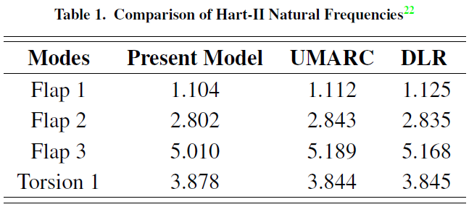
Structural Analysis: Beam Model
Hodges-Dowell type finite element based solver
15 degrees of freedom (flap, lag, axial and torsion)
First order system:
where,
J = Residual of structural equation
q = blade dof (displacements)
F = beam (aero) forcing
Solved via direct inversion
Beam FEM model
Notes:
The structural solver is a Hodges-Dowell beam type FEM based solver. Makes use of 15 dof, which includes, flap, lag, axial and torsion dof.
The system of equation is a typical mass-spring-damper type 2nd order system of equations and it can be simplified to a 1st order system of equation, such as:….
The solver has been validated by comparing the predicted fan plot for Hart-2 (Higher harmonic control Aeroacoustic Rotor Test combined program by German/Dutch/French/US in Oct 2001; 40% scaled BO-105) rotor with that from UMARC (UM advanced rotor code). The first three flap modes and 1st torsional mode has been very accurately captured, as shown in the table here for an operating rpm of 381RPM or 6.36hz or 40 rad/s.

Slide 33
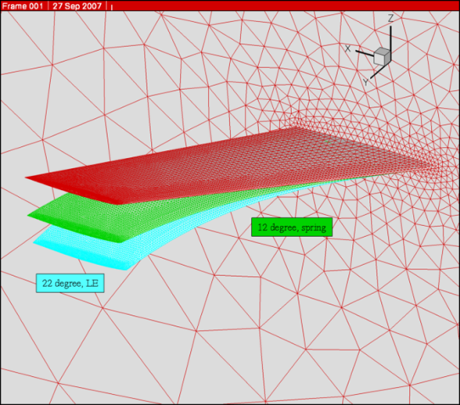
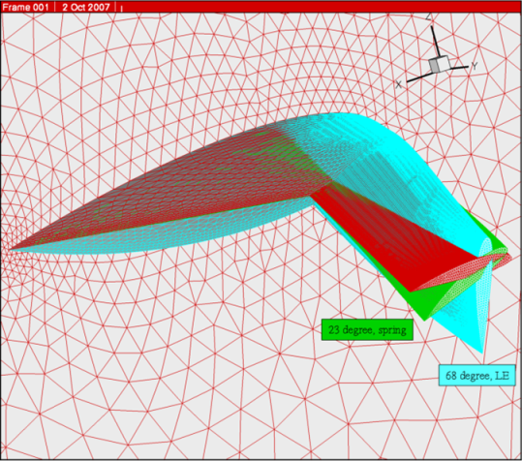
Mesh Deformation
Propagates surface displacements to interior mesh
Deflections from structural model at each time step (x^{n})
Design shape changes (D)
Based on linear elasticity analogy
(more robust than spring analogy)
Solved using line-implicit agglomeration multigrid (analogous to flow solver)
G(x^{n},x^{n}_{surf},D) = 0
Notes:
The structural solver is a Hodges-Dowell beam type FEM based solver. Makes use of 15 dof, which includes, flap, lag, axial and torsion dof.
The system of equation is a typical mass-spring-damper type 2nd order system of equations and it can be simplified to a 1st order system of equation, such as:….
The solver has been validated by comparing the predicted fan plot for Hart-2 (Higher harmonic control Aeroacoustic Rotor Test combined program by German/Dutch/French/US in Oct 2001; 40% scaled BO-105) rotor with that from UMARC (UM advanced rotor code). The first three flap modes and 1st torsional mode has been very accurately captured, as shown in the table here for an operating rpm of 381RPM or 6.36hz or 40 rad/s.

Slide 34
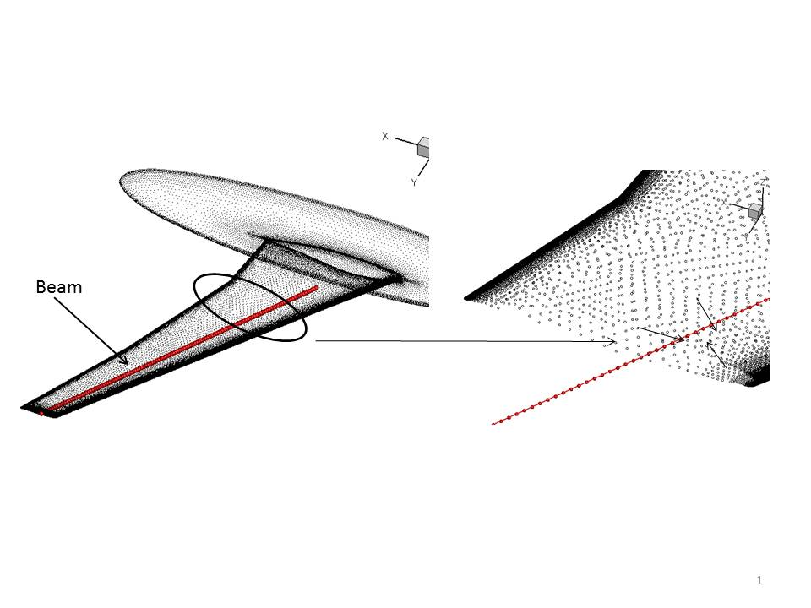
Fluid-Structure Interface (FSI)
Cloud of surface points associated with beam element
Forces projected onto beam element shape functions
Displacements projected back to CFD surface points using transpose
Notes:
The structural solver is a Hodges-Dowell beam type FEM based solver. Makes use of 15 dof, which includes, flap, lag, axial and torsion dof.
The system of equation is a typical mass-spring-damper type 2nd order system of equations and it can be simplified to a 1st order system of equation, such as:….
The solver has been validated by comparing the predicted fan plot for Hart-2 (Higher harmonic control Aeroacoustic Rotor Test combined program by German/Dutch/French/US in Oct 2001; 40% scaled BO-105) rotor with that from UMARC (UM advanced rotor code). The first three flap modes and 1st torsional mode has been very accurately captured, as shown in the table here for an operating rpm of 381RPM or 6.36hz or 40 rad/s.

Slide 35
CFD/CSD Coupling Time Integration Methodology
Outer loop over physical time steps
Coupling iterations per time step :
Mesh:
Line implicit multigrid
Flow:
Implicit BDF2 Newton iterations (GMRES)
Linear agglomeration multi-grid
FSI (Fluid to structure)
Explicit assignment
Structure:
Implicit BDF2 newton iteration (direct inversion)
FSI (Structure to fluid)
Explicit assignment

Slide 36
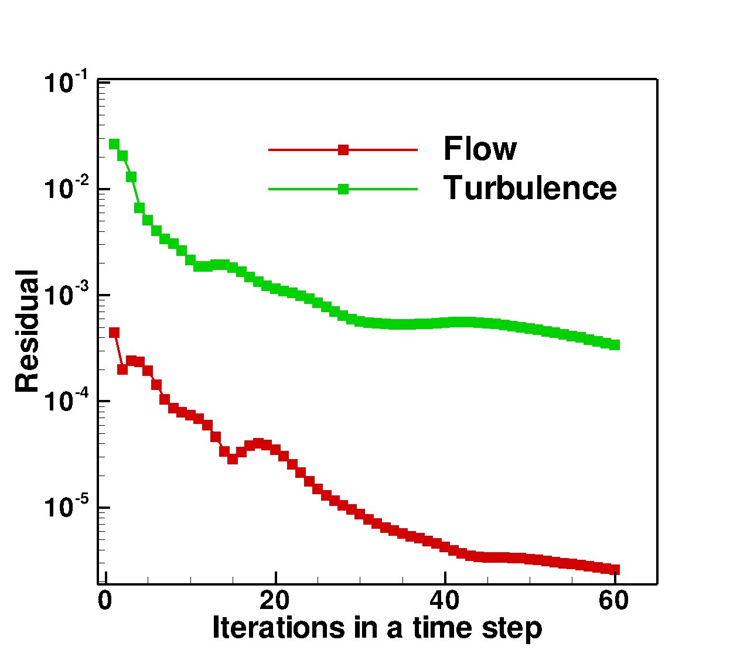
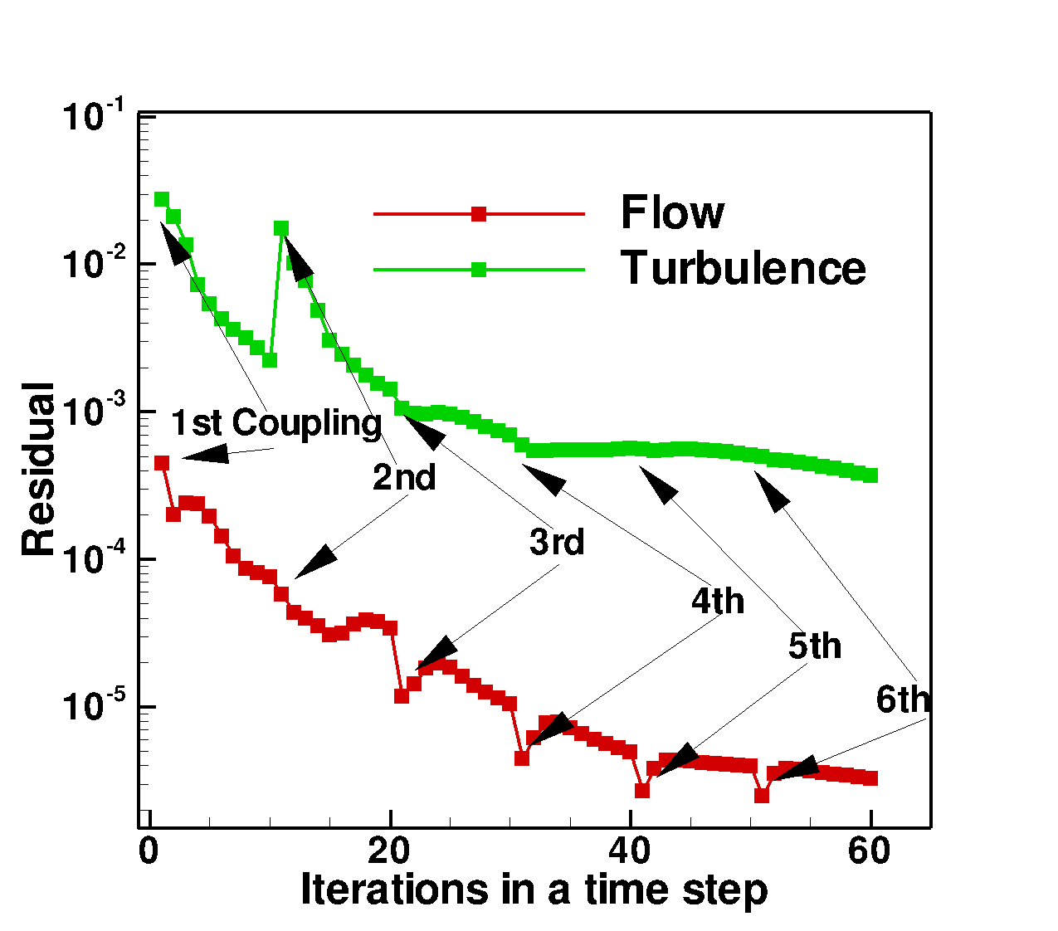
Analysis Convergence
Rigid blade convergence
Flexible blade convergence
60 non-linear iterations per time step
3 multigrid cycles/iteration
Convergence by 2 orders of magnitude
6 coupling cycles per time step
10 non-linear iterations/coupling with 3 multi-grid cycles/iteration
Convergence by 2 orders of magnitude

Slide 37
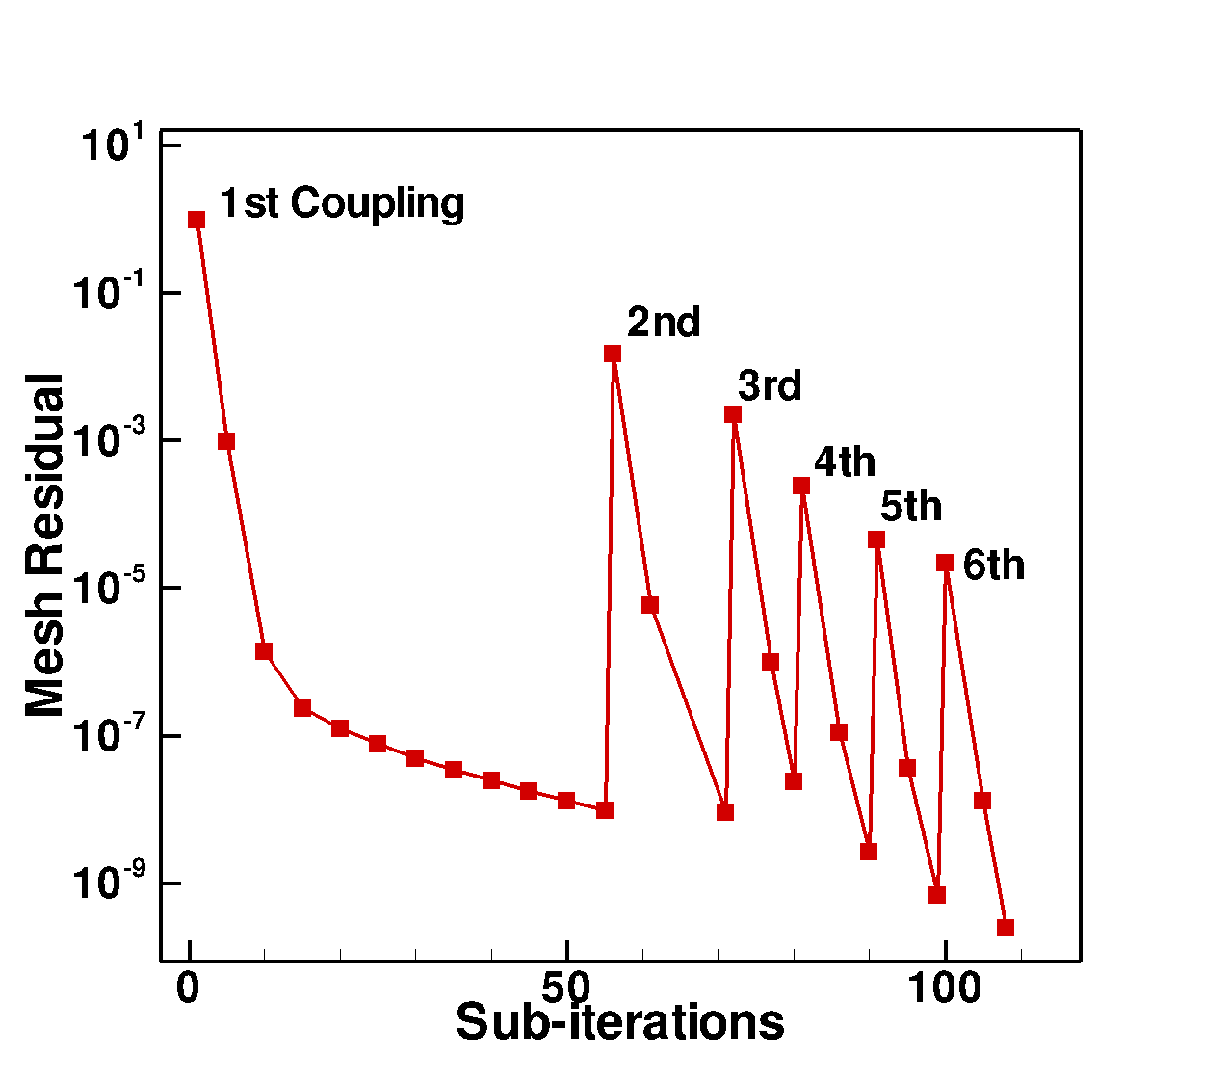
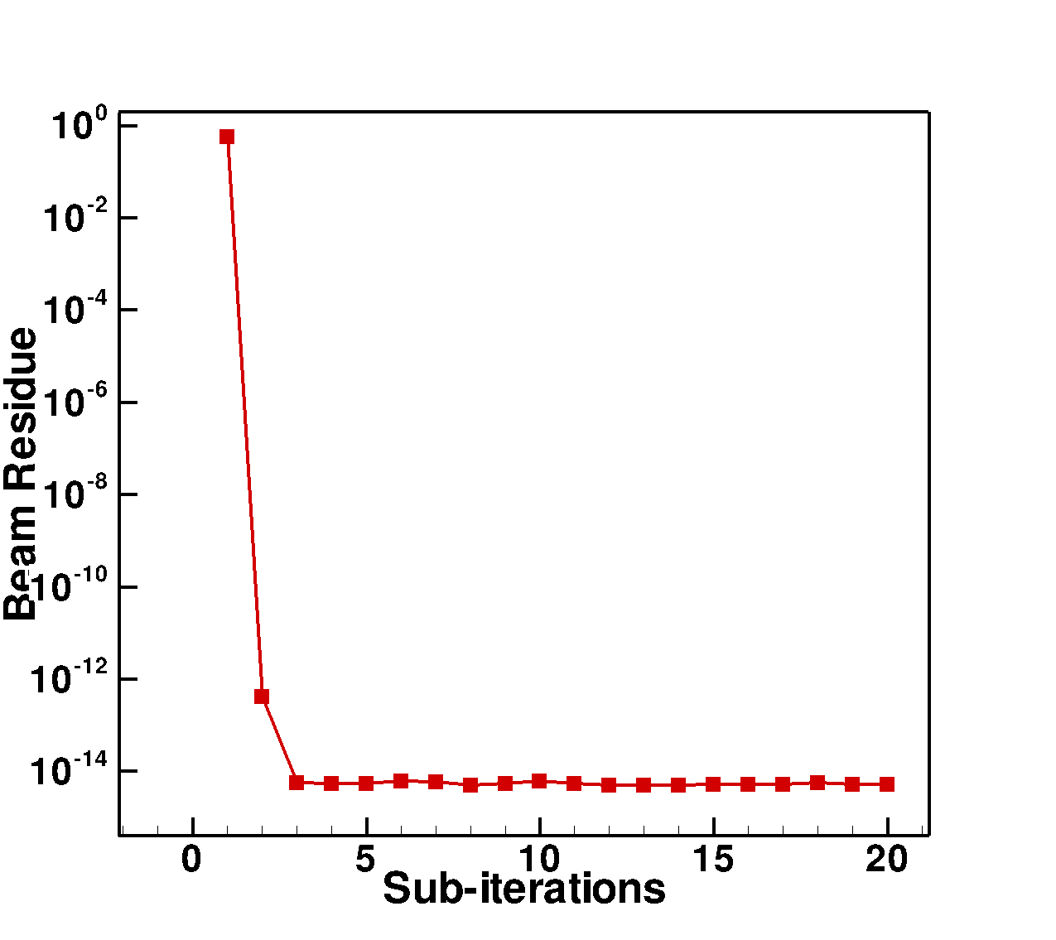
Convergence continued…
Mesh convergence per time step
CSD convergence per coupling per time step
Mesh solves upto 60 iterations or 1x10⁻⁹ (whichever earlier) per coupling
Mesh convergence by 10 orders of magnitude per time step (6 coupling cycles)
Beam convergence to machine precision (faster convergence)
Notes:
Reduction in later coupling mesh sub-iterations for convergence, because coupling is converging by then.

Slide 38
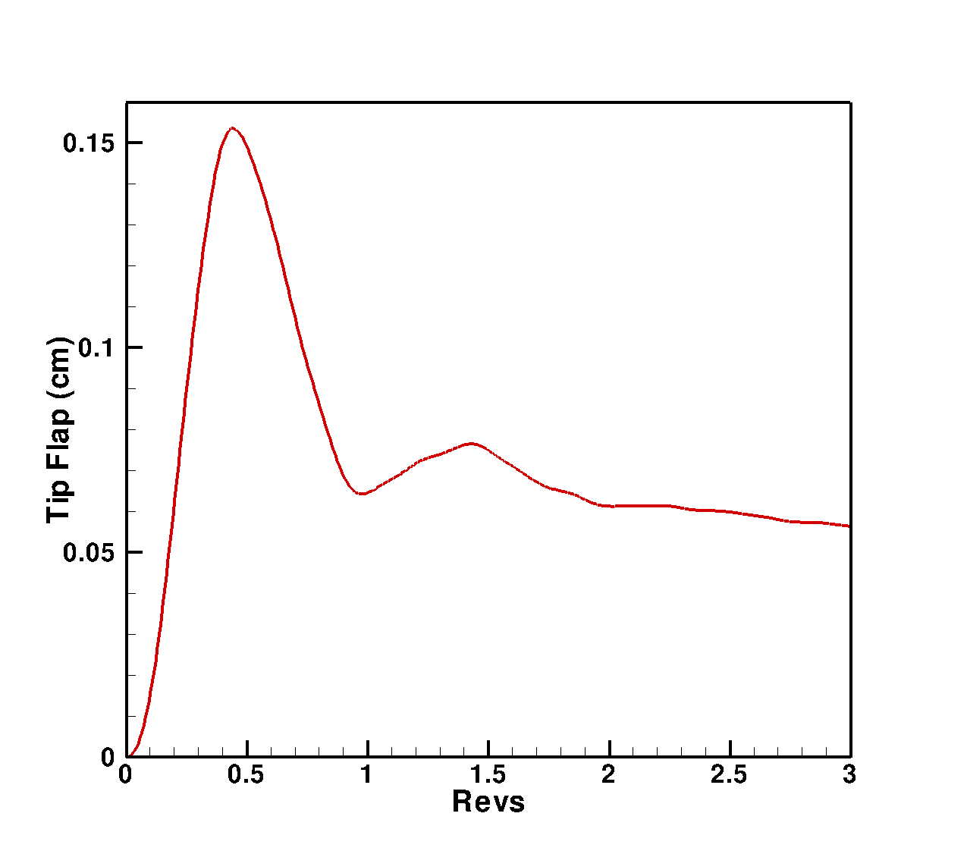
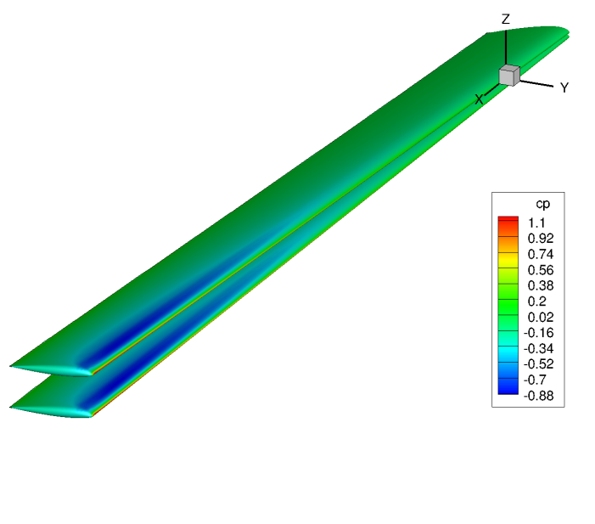
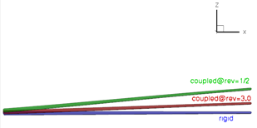
Blade Tip Time History
Surface Cp
(m)
Flexible
Rigid
Blade flap over time
Blade tip vs time
Blade flaps to high values, but converges to a lower value after 3 revs
Notes:
The surface pressure figure shows the existence of shock near the tip of Hart-II rotor blade, predicted both by the rigid as well as the flexible blade analysis. Mtip=0.64, rpm=1041 (109 rad/s)

Slide 39
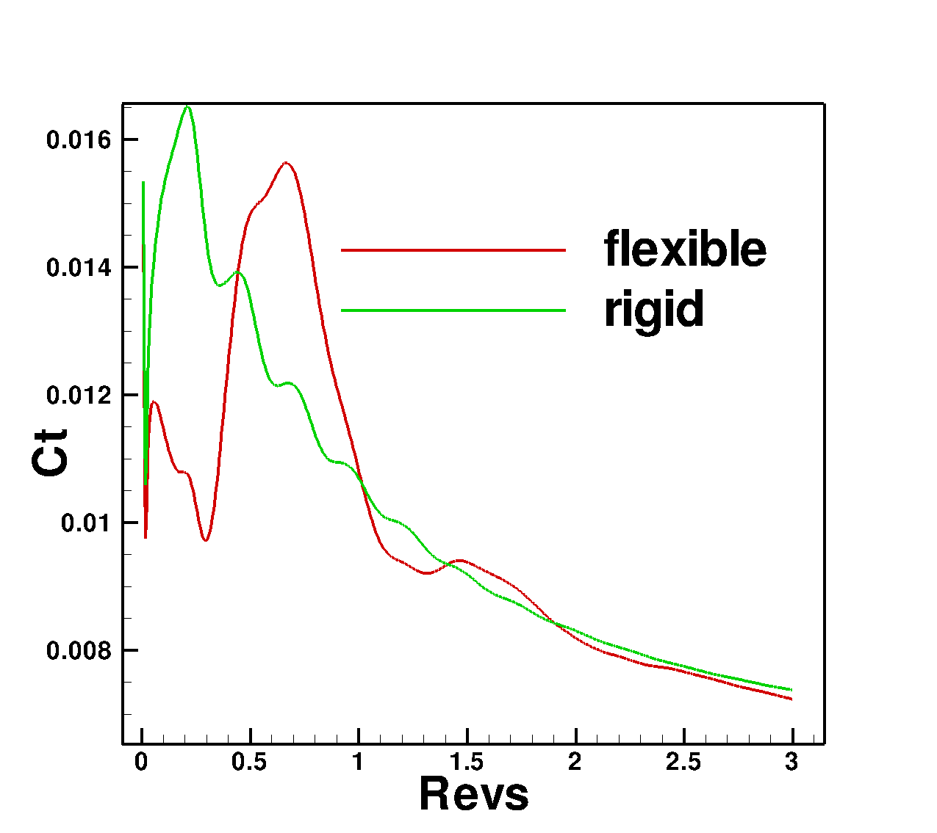
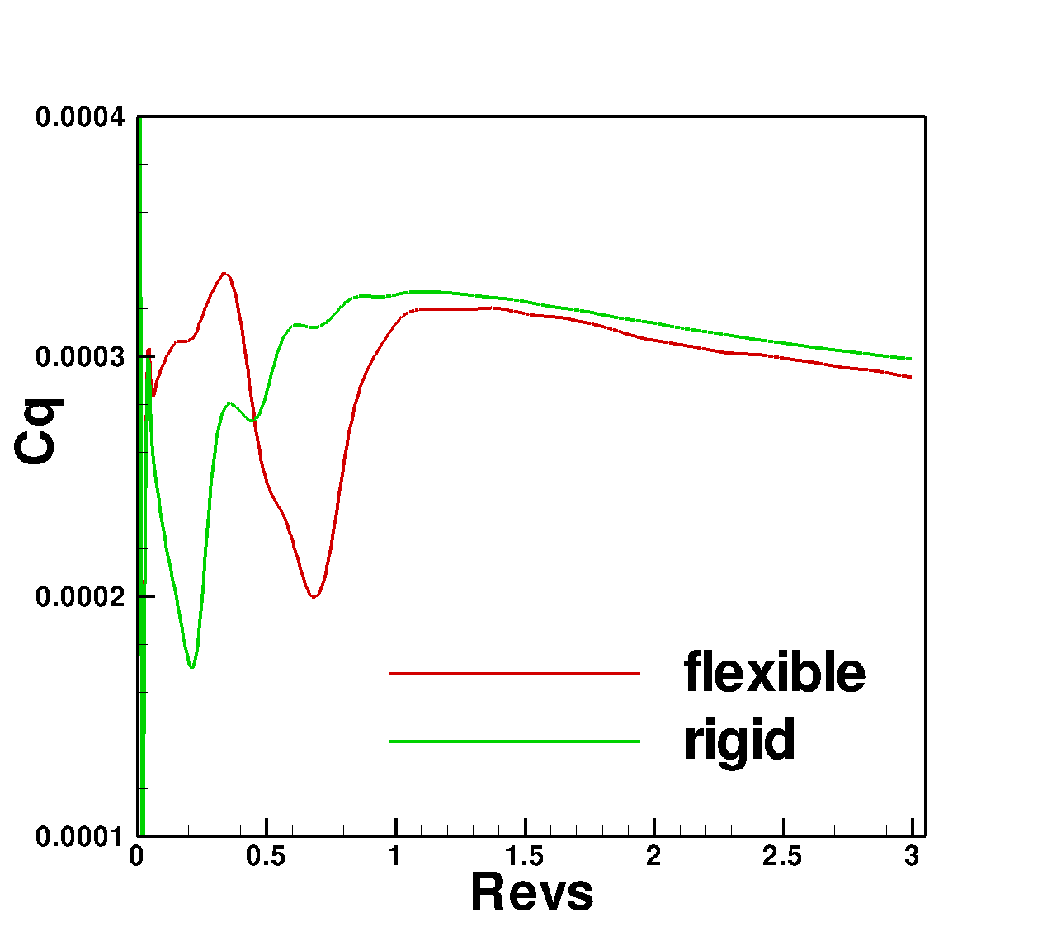
Hart-II Performance Prediction
Thrust vs time
Power vs time
Reduced thrust (~2%) and power (~2.5%) predicted by coupled analysis
Notes:
Simulating w/o flexible blade would result in overpredicting power penalty.

Slide 40
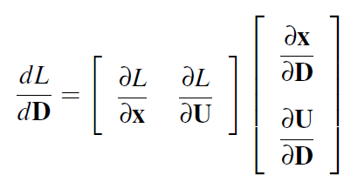
Aerodynamic Sensitivity: Tangent
Time-dependent objective function:
Linearizing w.r.t design variable ‘D’:
General expression for forward linearization of objective function w.r.t design variables:
Represents inner product over space and time
Notes:
A typical time-dependent objective function looks like: (give examples of L , D etc., define x , D etc.)
Sensitivity of the objective function wrt a design variable (geometric shape parameter) is:

Slide 41
Aerodynamic Sensitivity: Tangent
Constraint equation to be satisfied: Implicit residual at each time-step.
Mesh Motion Solver
Flow Solver
Linearize w.r.t design variables using chain rule:
System of constraint equations for time step n:
Notes:
This is forward linearization or tangent analysis. Equation shows, finding sensitivity vectors require dependence on ‘D’.
Most of the design problems involve multiple ‘D’ and usually a single ‘L’. To overcome dependence of ‘D’ adjoint approach comes to rescue.

Slide 42
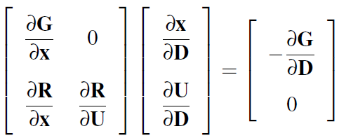
Aero Sensitivity: Tangent
Constraint equation to be satisfied: Implicit residual at each time-step.
Writing in generalized matrix form:
Equations dependent on D
Solution involves integrating forward over entire time domain
Notes:
This is forward linearization or tangent analysis. Equation shows, finding sensitivity vectors require dependence on ‘D’.
Most of the design problems involve multiple ‘D’ and usually a single ‘L’. To overcome dependence of ‘D’ adjoint approach comes to rescue.

Slide 43
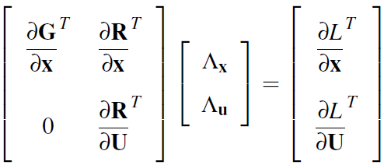
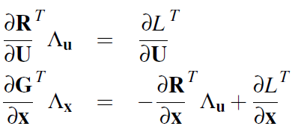
Aero Sensitivitiy: Adjoint
Adjoint equations:
Solve adjoint system:
Finally objective sensitivity:
Solution involves integrating
backward over entire time domain
Equations independent of D
Notes:
The adjoint approach is a sort of ‘reverse’ process of forward sensitivity formulation, which boils down to solving an system of equations for a pair of adjoint vectors corresponding to ‘mesh’ and ‘flow’, the jacobian being just the transpose of that of the tangent formulation. Sensitivity depends only on ‘L’ and not on ‘D’.

Slide 44
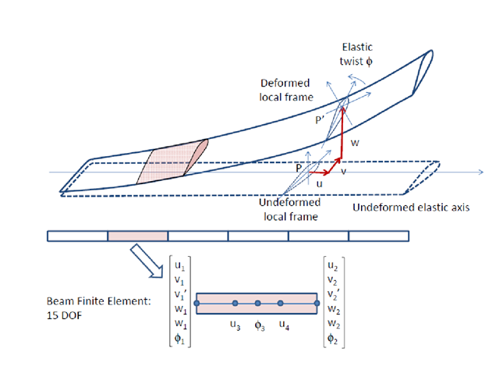
Structural Sensitivity
Objective function L,
Constraint:
Tangent:
Adjoint:
‘D’ can be structural or geometric shape parameters
Notes:
To look at the structural sensitivity, let’s look at a typical time-dependent structural beam objective function (which could be a function of beam deflection co-ordinates).

Slide 45
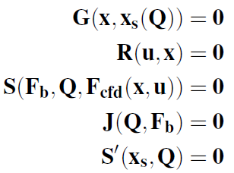
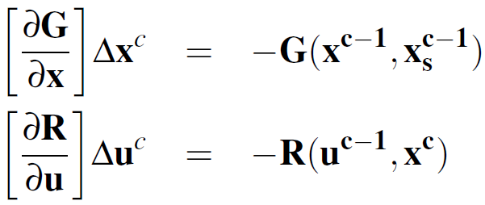
Fully Coupled Fluid-Structure Analysis
General solution
Per coupling cycle
Blade deformation transfer
Force transfer
Mesh:
Flow and mesh
Structure
Flow:
force transfer:
Structure:
Blade deformation transfer:
Notes:
Fully coupled analysis requires information exchange b/w fluid and structure every time step. This requires 2 additional equations, one for force transfer from CFD to CSD and the other is blade deformation transfer to interior mesh (CSD to CFD).

Slide 46
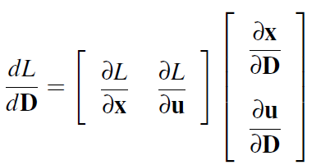
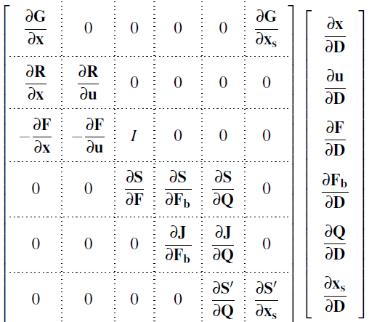
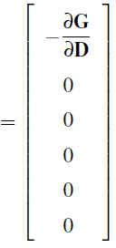
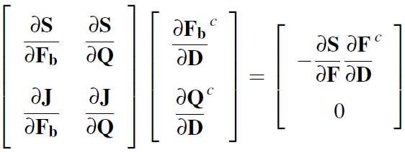
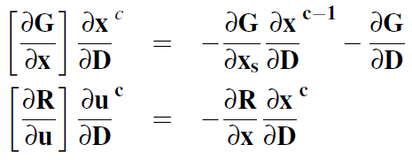
Fully Coupled Fluid-Structure Sensitivity: Tangent
Functional sensitivity:
Solve:
Per coupling
cycle
Force transfer and Structure
Surface force sensitivity
Mesh and Flow
Deformation transfer
Notes:
x=interior mesh, x_{s} = surface mesh

Slide 47
Fully Coupled Fluid-Structure Sensitivity: Adjoint
Solve:
Per coupling
cycle

Slide 48
Coupling Schematic
Force (F)
Start
Analysis
CFD
CSD
End
Deformation (X_{S})
Same data structures
(dF/dD)
Start
CFD
Tangent
CSD
Same solution strategy
End
(dX_{S}/dD)
Ʌ_{F}
Start
CFD
Adjoint
CSD
Ʌ_{Xs}
End

Slide 49
Blade Geometry Parametrization
Structured blade mesh overlap with CFD mesh
Hicks-Henne bump functions
Master blade shape defined by Hicks-Henne bump functions and twist
Defined by high-resolution structured mesh (in black)
Shape changes interpolated onto unstructured CFD surface mesh
112 design parameters
10 Hicks-Henne bump functions per blade section, 11 blade sections (110)
Twist at blade root and tip (2)
Notes:
To test the adjoint sensitivity of a given time-dependent objective function wrt blade geometry shape parameters as design variables, a ‘master blade shape’ is defined by using Hicks-Henne bump functions. The blade shapes are defined across 11 blade sections using 10 bump functions per section. The resulting ‘master blade shape’ is used to define a structured blade surface grid. Finally this surface blade geometry is mapped into the into CFD mesh by interpolating the structured blade surface co-ordinates onto the overlaping CFD surface blade mesh. These bump functions along with rotor twist at blade root and tip allows for 112 design parameters for optimizing blade shape.

Slide 50
Strongly Coupled Helicopter Blade Optimization
Time-integrated objective function:
Hart-II rotor (2.32x10⁶ grid) run for 2 revs (dt=2º)
Optimizer: L-BFGS-B bounded reduced Hessian
Bounds:
$±2\%$ chord on airfoil section
$±0.5$º twist
Parallel with 1024 cores
4 design cycles, 5 function calls, 1.4 hours per function call

Slide 51
Verification of Strongly Coupled CFD/CSD Adjoint Formulation
Time step | Method | $$\frac{{∂L}^{n}}{∂D}$$
1 | Complex | 3.690007037237534E-006
 | Tangent | 3.690007037237471E-006
 | Adjoint | 3.690007037237598E-006
2 | Complex | 5.150483530831191E-006
 | Tangent | 5.150483530831145E-006
 | Adjoint | 5.150483530831289E-006
3 | Complex | 5.828069793498591E-006
 | Tangent | 5.828069793498538E-006
 | Adjoint | 5.828069793498741E-006
4 | Complex | 6.056211086344925E-006
 | Tangent | 6.056211086344902E-006
 | Adjoint | 6.056211086345518E-006
5 | Complex | 6.026286742020757E-006
 | Tangent | 6.026286742020644E-006
 | Adjoint | 6.026286742020636E-006
Verified to 12 significant digits with complex version of complete coupled analysis
Verified over multiple time steps
Accuracy preserved over multiple time-steps
Notes:
Verified to 12 significant digits
Verified over multiple time steps
Accuracy preserved over multiple time-steps

Slide 52
Blade Optimization Results
Adjoint flow residual
Adjoint flow residual convergence by 5 orders
Functional dropping, gradient being reduced

Slide 53
Optimized Blade Sections
Baseline
Optimized
Thicker inboard and thinner outboard sections

Slide 54
Blade Optimization Results continued…
Optimized blade with (6%) less bending
Reduced power (2%) with small thrust (1% reduction)

Slide 55
Further Work
Optimization examples are illustrative only
More work required
Objective formulation
Design variable selection including structural design variables
Constraints
Moment constraint (trim)
Geometrical constraints, flow constraints, Maximum stress constraints , etc
Other areas of research
Second order methods (hessian matrix)
Non-local optimization
Gradient enhanced response surfaces

Slide 56
Second-Order Methods
Adjoint is efficient approach for calculating first-order sensitivities (first derivatives)
Second-order (Hessian) information can be useful for enhanced capabilities:
Optimization
Hessian corresponds to Jacobian of optimization problem (Newton optimization)
Unsteady optimization seems to be hard to converge
Optimization for stability derivatives
Optimization under uncertainty
Uncertainty quantification
Method of moments (Mean of inputs = input of means)
Inexpensive Monte-Carlo (using quadratic extrapolation)

Slide 57
Forward-Reverse Hessian Construction
Hessian for N inputs is a NxN matrix
Complete Hessian matrix can be computed with:
One tangent/forward problem for each input
One adjoint problem
Inner products involving local second derivatives computed with automatic differentiation
Overall cost is N+1 solves for NxN Hessian matrix
Lower than double finite-difference: O(N²)
May be impractical for large number of design variables
Can get Hessian vector products O(1) cost each

Slide 58
Hessian Implementation
Implemented for steady and unsteady 2D airfoil problems
Validated against double finite difference for Hicks-Henne bump function design variables

Slide 59
Newton Optimization with Hessian
LBFGS is “best” gradient-based optimizer
Constructs approximate Hessian based on previous design iterations
KNITRO is Newton optimizer
Requires Hessian as input
Superior performance in terms of number of function calls
Added cost of Hessian recovered (2 to 6 design variables)

Slide 60
Newton Optimization with Hessian
LBFGS is “best” gradient-based optimizer
Constructs approximate Hessian based on previous design iterations
KNITRO is Newton optimizer
Requires Hessian as input
Superior performance in terms of number of function calls
Added cost of Hessian recovered (2 to 6 design variables)

Slide 61
Newton Optimization with Hessian
LBFGS is “best” gradient-based optimizer
Constructs approximate Hessian based on previous design iterations
KNITRO is Newton optimizer
Requires Hessian as input
Superior performance in terms of number of function calls
Added cost of Hessian recovered (2 to 6 design variables)

Slide 62
Extrapolation with Hessian
Computed lift over a range of 1 shape design variable
Linear extrapolation :
Quadratic extrapolation :
Adjoint corrected linear extrapolation equivalent to cost of quadratic

Slide 63
Aerodynamic Data Modeling

Slide 64
Aerodynamic Data Modeling

Slide 65
2D Airfoil Shape Optimization

Slide 66
Conclusions
Adjoint formulation is powerful for obtaining sensitivities for problems with large numbers of design variables and few numbers of objectives
Discrete adjoint can be implemented in modular fashion and verified to machine precision
Using same data-structures/solution strategy as analysis
Applied to progressively more complex problems
Steady aerodynamics
Time dependent aerodynamics
Time-dependent aero-elastic problems
Beneficial extension possible through
Hessian formulations
Non-local optimization using gradient enhanced response surfaces

Slide 67
Acknowledgements
Faculty
Jay Sitaraman
Students and Postdoctoral Researchers
K. Mani, Z. Yang, R. Rumpfkeil, A. Mishra, W. Yamazaki
Alfred Gessow Rotorcraft Center of Excellence at University of Maryland
University of Wyoming ARCC and NCAR-Wyoming Supercomputer Center

Slide 68
Questions?

